Slide 1
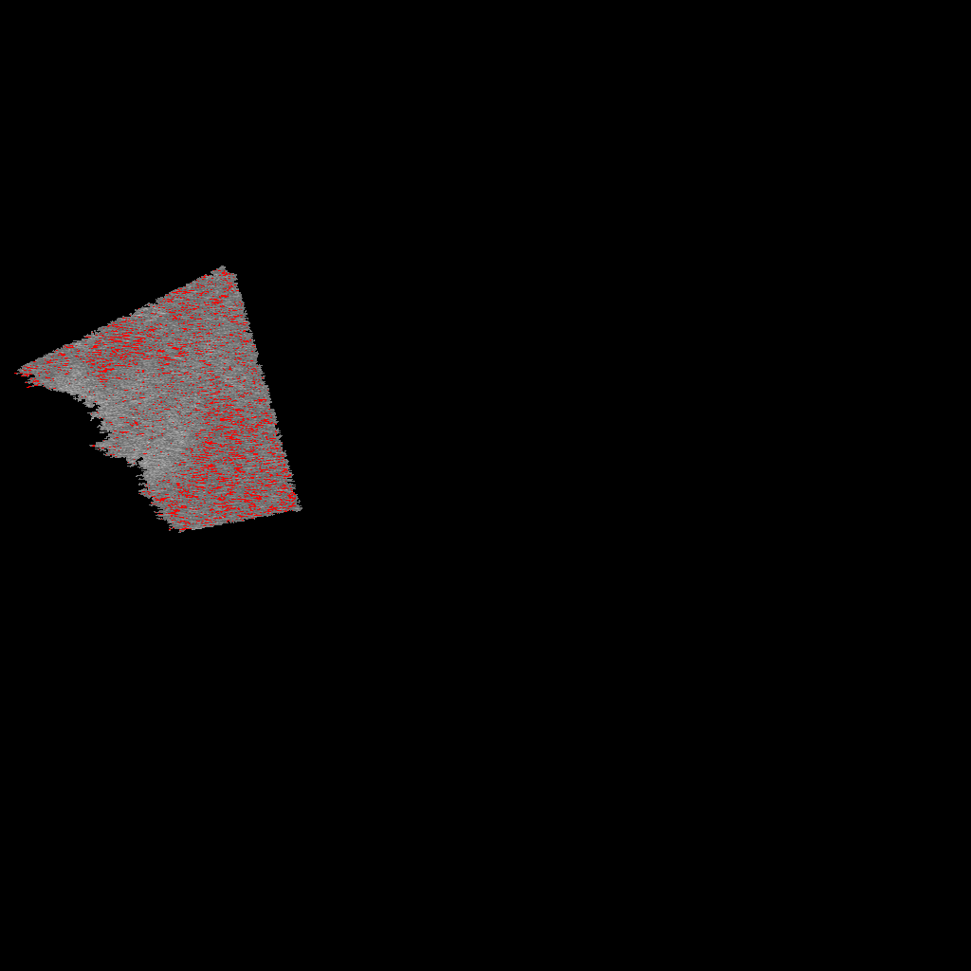




SP 1
Pixel Coordinates
SP 2
Pixel Coordinates
1) Stub Validation
2) ROI Ident.
SP 3
Pixel Coordinates
…
SP N
Pixel Coordinates

